Slide 1



PRODUCT BENCHMARK STUDY
XXX
Prepared For
Prepared By
MARKET INTELLIGENCE . CONSULTING
TSR/2022/486
February 3, 2023
www.techsciresearch.com

Slide 2
Report Content
Sl. No.
Report Content
Page No.
1
RESEARCH METHODOLOGY
4
1
EXECUTIVE SUMMARY
6-12
1
XXX
14-48

Slide 3

Research Methodology

Slide 4









Research Methodology
The recommended methodology for this study was based on exhaustive Secondary Research followed by extensive Primary Research. TechSci Research deployed a dedicated team who worked dedicatedly for the Client to meet research objectives.
Phase-I: Secondary Search: The team conducted exhaustive secondary research to collect the information on required set of data /information.
Phase-II: Formulating Questionnaire & Developing List of Respondents : Post Secondary Search, TechSci prepared a list of target individuals in target organization, across different functions and levels. In-addition, TechSci also identified individuals in distributors, participants in the supply chain, competitor companies, etc.
TechSci team formulated guidelines to ask specific questions related with the project objectives.
Phase-III: Extensive Primary Search : TechSci Research executed primary surveys targeting identified individuals in target organizations including their competitors' distributors, participants in the supply chain, through Telephonic methodology. TechSci Research performed periodical checks on data collected through telephonic surveys with logic checks and analyzed survey results.
Phase IV:
TechSci delivered the final comprehensive project report in detailed PDF format.
Target Audience Identification
Questionnaire Design and Finalization
Survey Execution
Data Cleaning and Validation
Survey Analysis
Reporting

Slide 5

Executive Summary & Conclusions

Slide 6
Executive Summary
240,015 Thousand USD
279,145 Thousand USD
240,015 Thousand USD
240,015 Thousand USD
Thinking Electronic’s Market Share | 2021 | 2022 | 2023 | 2024 | 2025
In NTC Thermistor Market (%) | XXX | XXX | XXX | XXX | XXX
In SMD NTC Thermistor Market (%) | XXX | XXX | XXX | XXX | XXX
Source: TechSci Research

Slide 7
Executive Summary
Manufacturing Locations | Key Products Manufactured | Total Production Capacity (Million Units) | Production Capacity By Target Products (Million Units)
 |  |  | TSM (SMD) | TSM - H (SMD) | TSM - C (Automotive)
Kaohsiung 1st Factory, Taiwan | NTC Thermistor, ESD Protection | XXX | XXX | XXX | XXX
Kaohsiung 2nd Factory, Taiwan | Temperature Sensor | XXX | XXX | XXX | XXX
Changzhou Factory, China | NTC Thermistor, Polymer PTC Thermistor, PTC Thermistor | XXX | XXX | XXX | XXX
Yichang Factory, China | NTC Thermistor, Polymer PTC Thermistor, Temperature Sensor | XXX | XXX | XXX | XXX
Dongguan Factory, China | NTC Thermistor, Polymer PTC Thermistor, Temperature Sensor | XXX | XXX | XXX | XXX
Yilan, Taiwan | NTC Thermistor, TVS Diode | XXX | XXX | XXX | XXX
Note: XXX
XXX
XXX
XXX
XXX
XXX
XXX
XXX
XXX
XXX
Source: TechSci Research, Thinking Electronic Company Website, Annual Reports, etc.

Slide 8
Executive Summary
Materials Research And Development Site And Future Plans
XXX
XXX
Investment in New Plants: XXX
XXX
XXX
Key Competitors– By Product & By Market
Company Name | Headquarters Location
XXX | XXX
XXX | XXX
XXX | XXX
Other Competitors – By Product & By Market | Munich, Germany
Company Name | Headquarters Location
XXX | XXX
XXX | XXX
XXX | XXX
XXX | XXX
XXX | XXX
XXX | XXX
XXX | XXX
XXX | XXX
XXX | XXX
XXX | XXX
XXX | XXX
XXX | XXX
XXX | XXX
Other Competitors – By Product & By Market | Munich, Germany
Company Name | Headquarters Location
XXX | XXX
XXX | XXX
XXX | XXX
XXX | XXX
XXX
XXX
XXX
Source: TechSci Research

Slide 9
Executive Summary
Below graph represents the corporate sales network of Thinking Electronic for the target products.
Target Products
Raw Material Suppliers
XXX
XXX
XXX
XXX
XXX
XXX
XXX
XXX
XXX
XXX
XXX
XXX
Source: TechSci Research

Slide 10
Executive Summary
XXX
XXX
XXX
XXX
Plans And Measures
XXX
XXX
XXX
XXX
Source: TechSci Research

Slide 11
Executive Summary
Distribution Of Key Personnel: Direct/Indirect Ratio (As of 2021)
Parameters |  | Number of Employees | % Contribution
Direct Employees | Direct Employees | XXX | XXX
Indirect Employees | Indirect Employees | XXX | XXX
Total | Total | XXX | XXX
Average Age |  | XXX
Average Years of Service |  | XXX
Education | Masters | XXX
 | University and College | XXX
 | Senior High School | XXX
 | Below Senior High School | XXX
Employees By Department
Department |  | Number of Employees
Operational Department |  | XXX
Main Management Department |  | XXX
Production Department |  | XXX
R&D Department |  | XXX
Production Control Department |  | XXX
Automation Department |  | XXX
Quality Assurance Department |  | XXX
Labour Safety Office |  | XXX
Production Department Segmentation
TSM (SMD) | XXX
TSM - H (SMD) | XXX
TSM - C (Automotive) | XXX
Employees By Factory (Production Department)
Factory | Number of Employees
Kaohsiung 1st Factory, Taiwan | XXX
Kaohsiung 2nd Factory, Taiwan | XXX
Changzhou Factory, China | XXX
Yichang Factory, China | XXX
Dongguan Factory, China | XXX
Jingdezhen Factory, China | XXX
Yilan, Taiwan | XXX
Each product has a separate manufacturing line, and the production lines are not mixed with each other.
Note: No. of employees by target product is an indicative number.
Source: TechSci Research

Slide 12
Executive Summary
Key Customers, 2021
Customer Name | % Share of Total Sales | Sales By Value (Thousand USD) | Sales By Value For NTC Thermistor (Thousand USD)
XXX | XXX | XXX | XXX
XXX | XXX | XXX | XXX
XXX | XXX | XXX | XXX
XXX | XXX | XXX | XXX
XXX | XXX | XXX | XXX
XXX | XXX | XXX | XXX
XXX
XXX
Work Shift Organization Status: Operating Days, Hours: XXX
XXX
Parameters | Cost | Accumulated Depreciation
 | Balance at December 31, 2021 (USD Million) | Balance at December 31, 2021 (USD Million)
XXX | XXX | XXX
XXX | XXX | XXX
XXX | XXX | XXX
XXX | XXX | XXX
XXX | XXX | XXX
XXX | XXX | XXX
XXX | XXX | XXX
Buildings: XXX
Raw Materials: XXX
XXX
XXX
Exchange Rate Used US$1=NT$27.68
Source: TechSci Research, Thinking Electronic Company Website, Annual Reports, Company Presentation, etc.

Slide 13
XXX

Slide 14
XXX – Product Overview
NTC Thermistor ( TSM (SMD), TSM - H (SMD), TSM - C (Automotive) )
XXX
XXX.
XXX
XXX
XXX
XXX
XXX
XXX
XXX
XXX
XXX
Applications:
Temperature Measurement: XXX
Temperature Control: XXX
Temperature Compensation: XXX.
Inrush Current Suppressing: XXX
Liquid Level Sensing: XXX.
Source: Thinking Electronic Company Website, Annual Reports, Company Presentation, etc.

Slide 15
XXX - Business Description
Headquarters: XXX
Geographical Presence:
Sales Office: XXX
Sales Representative: XXX
Manufacturing Plant: XXX
Distributors: XXX
Product Offerings:
XXX
XXX
Some common applications areas for target product are:
XXX: XXX.
XXX: XXX
XXX: XXX
XXX: XXX
XXX: XXX
XXX: XXX
XXX: XXX
XXX: XXX
Source: Thinking Electronic Company Website, Annual Reports, Company Presentation, etc.

Slide 16
XXX – Target Product
Name | Application | R25 (Ohm) | Features | Storage
XXX | XXX | XXX | XXX XXX XXX XXX XXX XXX XXX | XXX XXX XXX XXX XXX XXX XXX
XXX | XXX | XXX | XXX XXX XXX XXX XXX XXX XXX | XXX XXX XXX XXX XXX XXX XXX
XXX | XXX | XXX | XXX XXX XXX XXX XXX XXX XXX XXX XXX | XXX XXX XXX XXX XXX XXX XXX XXX XXX
Source: Thinking Electronic Company Website, Annual Reports, Company Presentation, etc.

Slide 17
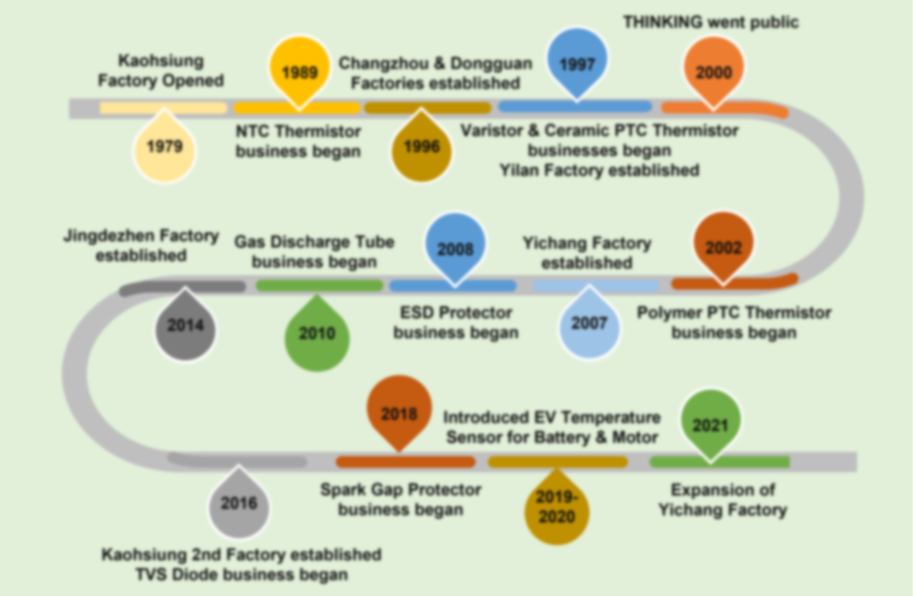
XXX – Corporate Milestones
Source: Thinking Electronic Company Website, Annual Reports, Company Presentation, etc.

Slide 18
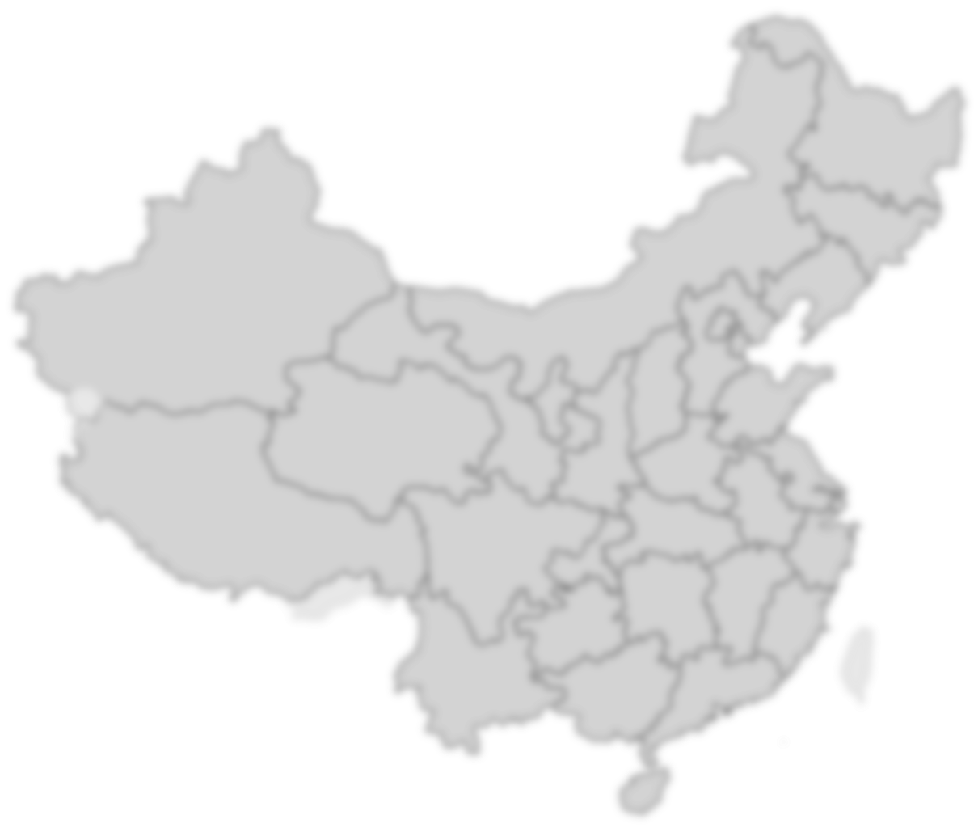




XXX – Manufacturing Plant
Manufacturing Locations:
XXX
XXX
XXX
XXX
XXX
XXX
XXX
Source: Thinking Electronic Company Website, Annual Reports, Company Presentation, etc.

Slide 19




XXX – Global Locations
Sales Office: XXX
Sales Representative: XXX
Distributors: XXX
Source: Thinking Electronic Company Website, Annual Reports, Company Presentation, etc.

Slide 20
XXX – Manufacturing Plant
Manufacturing Locations | Key Products Manufactured | Total Production Capacity (Million Units) | Production Capacity By Target Products (Million Units)
 |  |  | XXX | XXX | XXX
XXX | XXX | XXX | XXX | XXX | XXX
XXX | XXX | XXX | XXX | XXX | XXX
XXX | XXX | XXX | XXX | XXX | XXX
XXX | XXX | XXX | XXX | XXX | XXX
XXX | XXX | XXX | XXX | XXX | XXX
XXX | XXX | XXX | XXX | XXX | XXX
Note: XXX
XXX
XXX
XXX
XXX
XXX
XXX
XXX
XXX
XXX
Source: TechSci Research, Thinking Electronic Company Website, Annual Reports, etc.

Slide 21
XXX – Manufacturing Plant
Buildings
XXX
Parameters | Cost | Accumulated Depreciation
 | Balance at December 31, 2021 (USD Million) | Balance at December 31, 2021 (USD Million)
Land | XXX | XXX
Buildings | XXX | XXX
Machinery and Equipment | XXX | XXX
Leasehold Improvement | XXX | XXX
Others | XXX | XXX
Property Under Construction | XXX | XXX
Total | XXX | XXX
Exchange Rate Used US$1=NT$27.68
Raw Materials
XXX
XXX
XXX
XXX
XXX
XXX
XXX
Source: Thinking Electronic Company Website, Annual Reports, Company Presentation, etc.

Slide 22
XXX – Sales
Parameters | 2021 | 2022 | 2023 | 2024 | 2025
Total Sales | XXX | XXX | XXX | XXX | XXX
XXX | XXX | XXX | XXX | XXX | XXX
XXX | XXX | XXX | XXX | XXX | XXX
XXX | XXX | XXX | XXX | XXX | XXX
XXX | XXX | XXX | XXX | XXX | XXX
All values are in Thousands USD
Parameters | 2017 | 2018 | 2019 | 2020 | 2021
Profit Before Tax (Thousands USD) | XXX | XXX | XXX | XXX | XXX
Net profit (Thousands USD) | XXX | XXX | XXX | XXX | XXX
Thinking Electronic’s Market Share | 2021 | 2022 | 2023 | 2024 | 2025
In NTC Thermistor Market (%) | XXX | XXX | XXX | XXX | XXX
In SMD NTC Thermistor Market (%) | XXX | XXX | XXX | XXX | XXX
240,015 Thousand USD
279,145 Thousand USD
Source: TechSci Research, Thinking Electronic Company Website, Annual Reports, Company Presentation, etc.

Slide 23
XXX – Sales
Sales By Market (USD Million) | 2021
Information and Communication Technology | XXX
Medical and Others | XXX
Automotive and Industrial | XXX
Home Appliances and Lighting | XXX
Sales By Region (USD Million) | 2021
Asia | XXX
Europe | XXX
Taiwan | XXX
Others | XXX
Sales By Business Category (USD Million) | 2021
Protection Element - Export | XXX
Protection Element - Local Sales | XXX
Other - Local Sales | XXX
Other - Export | XXX
XXX Thousand USD
XXX Thousand USD
Source: TechSci Research, Thinking Electronic Company Website, Annual Reports, Company Presentation, etc.

Slide 24
XXX – Investments
Investment Plan
Re-investment policy:
XXX
XXX
XXX
XXX
Investment plan for 2023
XXX
XXX
XXX
XXX
Investment in New Plants
XXX
XXX
XXX
XXX
Materials Research And Development Site And Future Plans
XXX
XXX
Source: Thinking Electronic Company Website, Annual Reports, Company Presentation, etc.

Slide 25
XXX - New Products and Services Planned
New Products And Services Planned To Be Developed
XXX
XXX
XXX
XXX
XXX
XXX
XXX
XXX
XXX
XXX
Source: Thinking Electronic Company Website, Annual Reports, Company Presentation, etc.

Slide 26
XXX - New Products and Services Planned
New Products And Services Planned To Be Developed
XXX
XXX
XXX
XXX
XXX
XXX
XXX
XXX
XXX
XXX
Source: Thinking Electronic Company Website, Annual Reports, Company Presentation, etc.

Slide 27
XXX - New Products and Services Planned
New Products And Services Planned To Be Developed
The company is giving more weightage in research & development of below mentioned products:
XXX
XXX
XXX
XXX
XXX
XXX
XXX
XXX
XXX
XXX
XXX
XXX
XXX
XXX
XXX
XXX
Source: Thinking Electronic Company Website, Annual Reports, Company Presentation, etc.

Slide 28
XXX - Product Development Trend
Product Development Trend (Target Product)
XXX
XXX
XXX
XXX
XXX
XXX
XXX
XXX
XXX
XXX
XXX
XXX
XXX
XXX
XXX
XXX
Source: Thinking Electronic Company Website, Annual Reports, Company Presentation, etc.

Slide 29
XXX - Priority Markets And Products
Priority Development Markets
XXX
XXX
XXX
XXX
XXX
XXX
XXX
XXX
XXX
XXX
XXX
XXX
XXX
XXX
XXX
XXX
Source: Thinking Electronic Company Website, Annual Reports, Company Presentation, etc.

Slide 30
XXX - Priority Markets And Products
XXX Thousand USD
Priority Sales Products
XXX
XXX
XXX
XXX
XXX
XXX
XXX
XXX
XXX
Source: Thinking Electronic Company Website, Annual Reports, Company Presentation, etc.

Slide 31
XXX - Priority Markets And Products
XXX
XXX
XXX
XXX
XXX
XXX
XXX
XXX
XXX
XXX Thousand USD
Others include Polymer PTC Resettable Fuse, Gas Discharge Tube, ESD Suppressor, TVS Diode, Spark Gap Protector, Thyristor Surge Suppressor
Source: Thinking Electronic Company Website, Annual Reports, Company Presentation, etc.

Slide 32
Executive Summary
Below graph represents the corporate sales network of Thinking Electronic for the target products.
Target Products
Raw Material Suppliers
XXX
XXX
XXX
XXX
XXX
XXX
XXX
XXX
XXX
XXX
XXX
XXX
Source: TechSci Research

Slide 33
Executive Summary
XXX
XXX
XXX
XXX
Plans And Measures
XXX
XXX
XXX
XXX
Source: TechSci Research

Slide 34
XXX – Manufacturing Cost Reduction
XXX
XXX
XXX
XXX
XXX
XXX
XXX
XXX
XXX
XXX
XXX
XXX
XXX
XXX
XXX
XXX
XXX
XXX
XXX
XXX
Source: Thinking Electronic Company Website, Annual Reports, Company Presentation, etc.

Slide 35
XXX – Manufacturing Cost Reduction
XXX
XXX
XXX
XXX
XXX
XXX
XXX
XXX
XXX
XXX
XXX
XXX
XXX
XXX
XXX
Source: Thinking Electronic Company Website, Annual Reports, Company Presentation, etc.

Slide 36
XXX - Composition Of Corporate Organization
XXX
XXX
XXX
XXX
XXX
XXX
XXX
XXX
XXX
XXX
XXX
XXX
XXX
XXX
XXX
XXX
XXX
XXX
XXX
XXX
Production XXX
XXX
Source: Thinking Electronic Company Website, Annual Reports, Company Presentation, etc.

Slide 37
XXX – Distribution of Key Personnel
Distribution Of Key Personnel: Direct/Indirect Ratio (As of 2021)
Parameters |  | Number of Employees | % Contribution
Direct Employees | Direct Employees | XXX | XXX
Indirect Employees | Indirect Employees | XXX | XXX
Total | Total | XXX | XXX
Average Age |  | XXX
Average Years of Service |  | XXX
Education | Masters | XXX
 | University and College | XXX
 | Senior High School | XXX
 | Below Senior High School | XXX
Employees By Department
Department |  | Number of Employees
Operational Department |  | XXX
Main Management Department |  | XXX
Production Department |  | XXX
R&D Department |  | XXX
Production Control Department |  | XXX
Automation Department |  | XXX
Quality Assurance Department |  | XXX
Labour Safety Office |  | XXX
Production Department Segmentation
TSM (SMD) | XXX
TSM - H (SMD) | XXX
TSM - C (Automotive) | XXX
Employees By Factory (Production Department)
Factory | Number of Employees
Kaohsiung 1st Factory, Taiwan | XXX
Kaohsiung 2nd Factory, Taiwan | XXX
Changzhou Factory, China | XXX
Yichang Factory, China | XXX
Dongguan Factory, China | XXX
Jingdezhen Factory, China | XXX
Yilan, Taiwan | XXX
Each product has a separate manufacturing line, and the production lines are not mixed with each other.
Note: No. of employees by target product is an indicative number.
Source: TechSci Research, Thinking Electronic Company Website, Annual Reports, Company Presentation, etc.

Slide 38
XXX – Social Background Of Senior Corporate Management
Title | Directors |  |  |  | Independent Directors
Nationality /Place of Incorporation | Republic of China
Name | XXX | XXX | XXX | XXX | XXX | XXX | XXX
Gender | XXX | XXX | XXX | XXX | XXX | XXX | XXX
Age | XXX | XXX | XXX | XXX | XXX | XXX | XXX
Experience (Education) | XXX | XXX | XXX | XXX | XXX | XXX | XXX
Professional qualifications and experience | XXX | XXX | XXX | XXX | XXX | XXX | XXX
Source: Thinking Electronic Company Website, Annual Reports, Company Presentation, etc.

Slide 39
XXX – Social Background Of Senior Corporate Management
Title | Nationality /Place of Incorporation | Name | Gender | Education & Experience
XXX | XXX | XXX | XXX | XXX
XXX | XXX | XXX | XXX | XXX
XXX | XXX | XXX | XXX | XXX
XXX | XXX | XXX | XXX | XXX
XXX | XXX | XXX | XXX | XXX
XXX | XXX | XXX | XXX | XXX
XXX | XXX | XXX | XXX | XXX
XXX | XXX | XXX | XXX | XXX
XXX | XXX | XXX | XXX | XXX
XXX | XXX | XXX | XXX | XXX
Source: Thinking Electronic Company Website, Annual Reports, Company Presentation, etc.

Slide 40
XXX - Impact Of Government Subsidies On Businesses
XXX
XXX
XXX
XXX
XXX
XXX
XXX
XXX
XXX
XXX
XXX
XXX
XXX
XXX
XXX
XXX
XXX
Source: Thinking Electronic Company Website, Annual Reports, Company Presentation, etc.

Slide 41
XXX – Peer Benchmarking
Key Competitors– By Product & By Market
Company Name | Headquarters Location
XXX | XXX
XXX | XXX
XXX | XXX
Other Competitors – By Product & By Market | Munich, Germany
Company Name | Headquarters Location
XXX | XXX
XXX | XXX
XXX | XXX
XXX | XXX
XXX | XXX
XXX | XXX
XXX | XXX
XXX | XXX
XXX | XXX
XXX | XXX
XXX | XXX
XXX | XXX
XXX | XXX
Other Competitors – By Product & By Market | Munich, Germany
Company Name | Headquarters Location
XXX | XXX
XXX | XXX
XXX | XXX
XXX | XXX
XXX
XXX
XXX
XXX
XXX
Source: TechSci Research, Thinking Electronic Company Website, Annual Reports, Company Presentation, etc.

Slide 42
XXX - Key Customers
Key Customers, 2021
Customer Name | % Share of Total Sales | Sales By Value (Thousand USD) | Sales By Value For NTC Thermistor (Thousand USD)
XXX | XXX | XXX | XXX
XXX | XXX | XXX | XXX
XXX | XXX | XXX | XXX
XXX | XXX | XXX | XXX
XXX | XXX | XXX | XXX
XXX | XXX | XXX | XXX
XXX
XXX
Work Shift Organization Status: Operating Days, Hours
XXX XXX
XXX
Factory Wage Structure: Direct/Indirect Salary Structure (As of 2021)
Parameters | USD/month
Direct Salary (Production) | XXX
Indirect Salary (Others) | XXX
Source: TechSci Research, Thinking Electronic Company Website, Annual Reports, Company Presentation, etc.

Slide 43





XXX – Technical Staffing Status
XXX
XXX
XXX
XXX
XXX
Technical Consultation
XXX
Product Selection Suggestion
XXX
Technical Staffing Status
XXX
Circuit Design Assistance
XXX
Total Number of Technical Staff in Thinking Electronic
Department | Number of Employees
Automation Department | XXX
Production Control Department | XXX
Quality Assurance Department | XXX
Total | XXX
Application Example
XXX
Source: Thinking Electronic Company Website, Annual Reports, Company Presentation, etc.

Slide 44
XXX – Yield Change
Key initiatives taken by Thinking Electronic for good rate trend:
XXX
XXX
XXX
XXX
XXX
XXX
XXX
XXX
XXX
XXX
XXX
XXX
XXX
XXX
XXX
XXX
Source: Thinking Electronic Company Website, Annual Reports, Company Presentation, etc.

Slide 45
XXX – Yield Change
Key initiatives taken by Thinking Electronic for good rate trend:
Production policy:
Supply management:
XXX
XXX
XXX
XXX
XXX
XXX
XXX
Production management:
XXX
XXX
XXX
XXX
XXX
XXX
XXX
XXX
Source: Thinking Electronic Company Website, Annual Reports, Company Presentation, etc.

Slide 46
XXX – Good Rate Trend
XXX
XXX
XXX
XXX
XXX
XXX
XXX
XXX
Sales Policy:
XXX
XXX
XXX
XXX
XXX
XXX
XXX
XXX
XXX
Source: Thinking Electronic Company Website, Annual Reports, Company Presentation, etc.

Slide 47
XXX – Corporate Development Department Personnel Status
Title | Nationality /Place of Incorporation | Name | Gender | Education & Experience
XXX | XXX | XXX | XXX | XXX
XXX | XXX | XXX | XXX | XXX
XXX | XXX | XXX | XXX | XXX
XXX | XXX | XXX | XXX | XXX
XXX | XXX | XXX | XXX | XXX
XXX | XXX | XXX | XXX | XXX
XXX | XXX | XXX | XXX | XXX
XXX | XXX | XXX | XXX | XXX
XXX | XXX | XXX | XXX | XXX
XXX | XXX | XXX | XXX | XXX
Source: Thinking Electronic Company Website, Annual Reports, Company Presentation, etc.

Slide 48
XXX – Corporate Development Department Personnel Status
XXX
XXX
XXX
XXX
XXX
XXX
XXX
XXX
XXX
XXX
XXX
XXX
XXX
XXX
XXX
XXX
XXX
Source: Thinking Electronic Company Website, Annual Reports, Company Presentation, etc.

Slide 49

About Us & Disclaimer
TechSci Research is a global market research and consulting company with offices in the US, UK and India. TechSci Research provides market research reports in number of areas to organizations. The company uses innovative business models that focus on improving productivity, while ensuring creation of high-quality reports. The proprietary forecasting models use various analyses of both industry-specific and macroeconomic variables on a state-by-state basis to produce a unique ‘bottom-up’ model of a country, regional and global industry prospects. Combined with the detailed analysis of company activity and industry trends, the result is a uniquely rich evaluation of the opportunities available in the market.
TechSci Research – North America
708 Third Avenue, Manhattan,
New York, United States
Tel: +1- 646- 360- 1656
Email: sales@techsciresearch.com www.techsciresearch.com
TechSci Research – Europe
54, Old brook, Bretton,
Peterborough,
United Kingdom
Email: sales@techsciresearch.com www.techsciresearch.com
TechSci Research – Asia-Pacific
B – 44, Sector – 57, Noida, National Capital Region, U.P. - India
Tel: +91-120-4523900
Email: sales@techsciresearch.com www.techsciresearch.com
Disclaimer
The contents of this report are based on information generally available to the public from sources believed to be reliable. No representation is made that it is timely, accurate or complete. TechSci Research has taken due care and caution in compilation of data as this has been obtained from various sources including which it considers reliable and first hand. However, TechSci Research does not guarantee the accuracy, adequacy or completeness of any information and it is not responsible for any errors or omissions or for the results obtained from the use of such information and especially states that it has no financial liability whatsoever to the subscribers / users of this report. The information herein, together with all estimates and forecasts, can change without notice. All the figures provided in this document are indicative of relative market size and are strictly for client’s internal consumption. Usage of the same for purpose other than internal will require prior approval of TechSci Research.

